Slide 1
GitPub Quiz
Notes:
Grace to cover

Slide 2
1. What is GitHub primarily used for?
Hosting websites
Sharing videos
Version control and collaboration on code
Designing graphics
Looking at pictures of cats
Notes:
Plain slide with subhead and bullets

Slide 3
2. What is a repository (repo) in GitHub?
A backup of your computer
A folder that contains your project files and version history
A list of contributors
A type of GitHub user
Notes:
Plain slide with subhead and bullets

Slide 4
3. Finish this sentence: “A git clone…”
Deletes a repository
Creates a new branch
Copies a repository to your local machine
Uploads files to GitHub
Takes someone you’re not fond of and clones them
Notes:
Plain slide with subhead and bullets

Slide 5
4. What is a branch in GitHub?
A backup of your code
A separate version of your code for experimentation
A type of file
A GitHub user
Notes:
Plain slide with subhead and bullets

Slide 6
5. What is a pull request?
A request to delete a repository
A way to suggest changes to a project
A command to update Git
A GitHub notification
Notes:
Plain slide with subhead and bullets

Slide 7
6. True or False: You must use the command line to use GitHub
True
False
What’s the command line?!
Notes:
Plain slide with subhead and bullets

Slide 8
7. What does git pull do?
Downloads changes from a remote repository and merges them into your local branch
Saves changes locally
Uploads local commits to GitHub
Deletes your local repository and starts fresh
Notes:
Plain slide with subhead and bullets

Slide 9

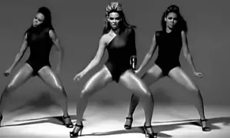
8. I make a commit in Git. What have I done?
Made a new repository
Created a new branch
Saved a version of my project
Put a ring on it
Notes:
Plain slide with subhead and bullets

Slide 10
9. What does git push do?
Downloads changes from GitHub
Uploads local commits to GitHub
Creates a new repository
Merges branches
Notes:
Plain slide with subhead and bullets

Slide 11
10. Which of the following is not a valid GitHub feature?
Issues
Forks
Commits
Filters
Notes:
Plain slide with subhead and bullets

Slide 12
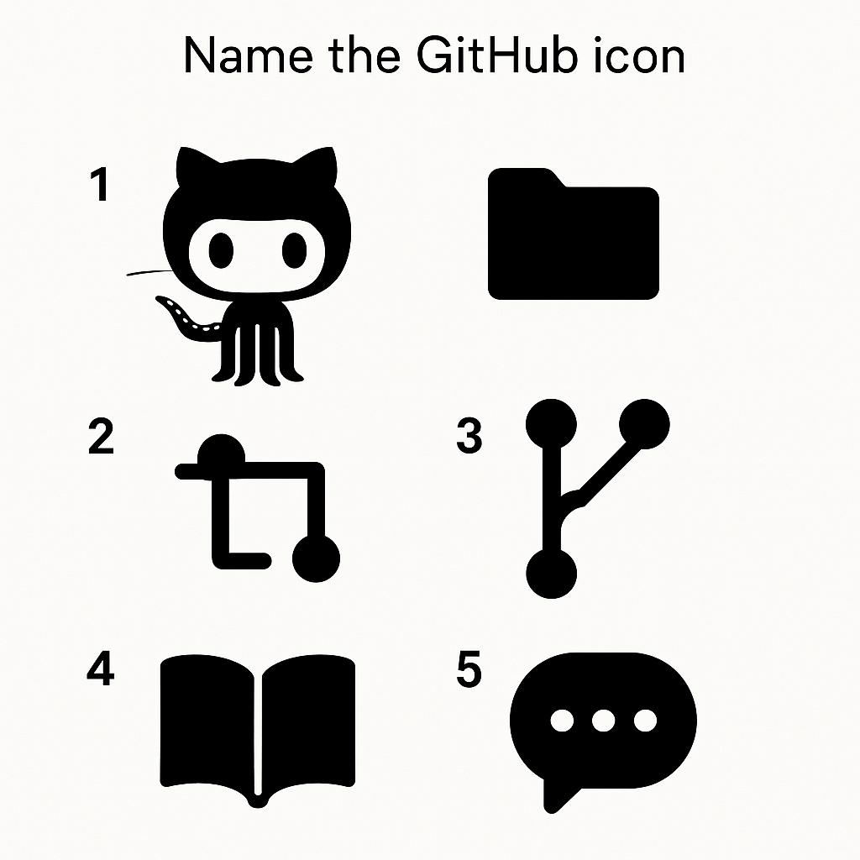




Picture round…
2
3
4
5
6
Notes:
Plain slide with subhead and bullets

Slide 13
Answers
Notes:
Grace to cover

Slide 14
1. What is GitHub primarily used for?
Hosting websites
Sharing videos
Version control and collaboration on code
Designing graphics
Looking at pictures of cats
Notes:
Plain slide with subhead and bullets

Slide 15
2. What is a repository (repo) in GitHub?
A backup of your computer
A folder that contains your project files and version history
A list of contributors
A type of GitHub user
Notes:
Plain slide with subhead and bullets

Slide 16
3. Finish this sentence: “A git clone…”
Deletes a repository
Creates a new branch
Copies a repository to your local machine
Uploads files to GitHub
Takes someone you’re not fond of and clones them
Notes:
Plain slide with subhead and bullets

Slide 17
4. What is a branch in GitHub?
A backup of your code
A separate version of your code for experimentation
A type of file
A GitHub user
Notes:
Plain slide with subhead and bullets

Slide 18
5. What is a pull request?
A request to delete a repository
A way to suggest changes to a project
A command to update Git
A GitHub notification
Notes:
pull request lets you propose changes to a repository. Others can review, discuss, and merge your changes if approved

Slide 19
6. True or False: You must use the command line to use GitHub
True
False
What’s the command line?!
Notes:
Plain slide with subhead and bullets

Slide 20
7. What does git pull do?
Downloads changes from a remote repository and merges them into your local branch
Saves changes locally
Uploads local commits to GitHub
Deletes your local repository and starts fresh
Notes:
Plain slide with subhead and bullets

Slide 21
8. I make a commit in Git. What have I done?
Made a new repository
Created a new branch
Saved a version of my project
Put a ring on it
Notes:
Plain slide with subhead and bullets

Slide 22
9. What does git push do?
Downloads changes from GitHub
Uploads local commits to GitHub
Creates a new repository
Merges branches
Notes:
Plain slide with subhead and bullets

Slide 23
10. Which of the following is not a valid GitHub feature?
Issues
Forks
Commits
Filters
Notes:
Plain slide with subhead and bullets

Slide 24
Picture round…
2. Folder or directory within a repo
2
1. GitHub logo
3
4
3. Pull request
4. Branch icon
5
6
6. Merge icon
5. README
Notes:
Octocat – GitHub’s mascot and logo
Pull Request icon – Used to propose and review changes before merging
Branch icon – Represents a Git branch (a separate line of development)
Book/Documentation icon – Typically links to project documentation or a README
Comment/Discussion icon – Used for issues, discussions, or code review comments

